Slide 1

Zero Downtime Web Application Deployment
- Under guidance of prof. Dhiraj Kharade and Prof. Shraddha Panchal
- Presented by TRUPTI PURANIK

Slide 2
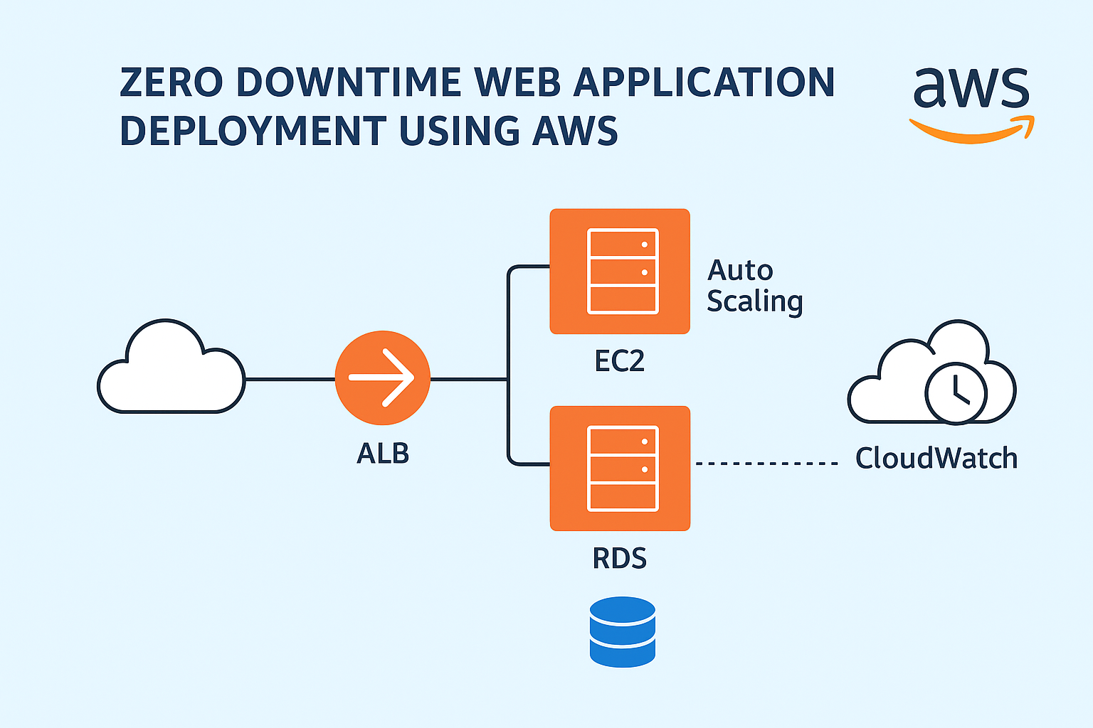
AGENDA
Introduction
Aim And Objectives
Tools and Technologies used
Work Implementation
Conclusion

Slide 3
INTRODUCTION
Business rely on web application for continuous service.
Even Short downtime can cause financial loss.
AWS ensures high availability and reliability through its cloud infrastructure.

Slide 4
AIM AND OBJECTIVES
AIM:
Deploy a zero downtime web application using AWS services
OBJECTIVES:
Host Web App using EC2 and RDS
Implement ALB for Load distribution.
Configure autoscaling for dynamic scaling.
Use CloudWatch for monitoring.

Slide 5
TOOLS AND TECHNOLOGIES USED
EC2 – Hosting the application
RDS – Database
Application Load Balancer – Traffic distribution
Auto Scaling Group – Scaling
CloudWatch – Monitoring
IAM, Security Groups – Access & networking

Slide 6
WORK IMPLEMENTATION
• EC2 Setup: Launch instances with Apache, PHP, and web app.
• RDS: Configure managed MySQL database.
• ALB: Distribute traffic across healthy EC2s.
• Auto Scaling: Adjust instance count automatically.
• Validation: Terminate instance and verify uninterrupted access.

Slide 7
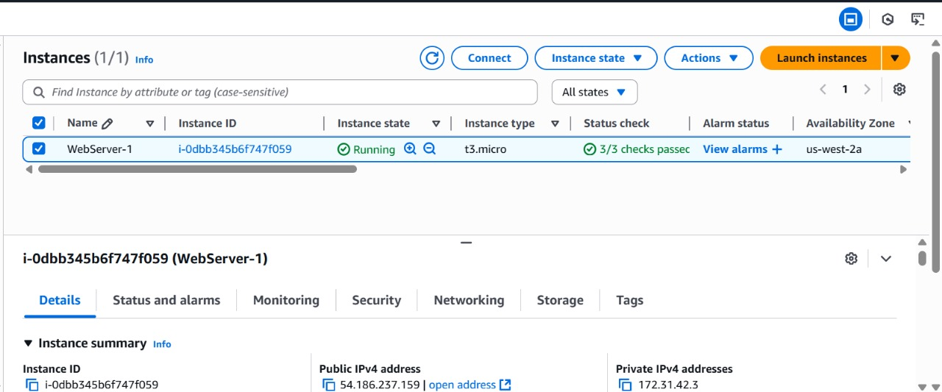
EC2 Setup:
User Data:
#!/bin/bash yum update –y yum install -y httpd php php-mysqlnd systemctl start httpd systemctl enable httpd

Slide 8
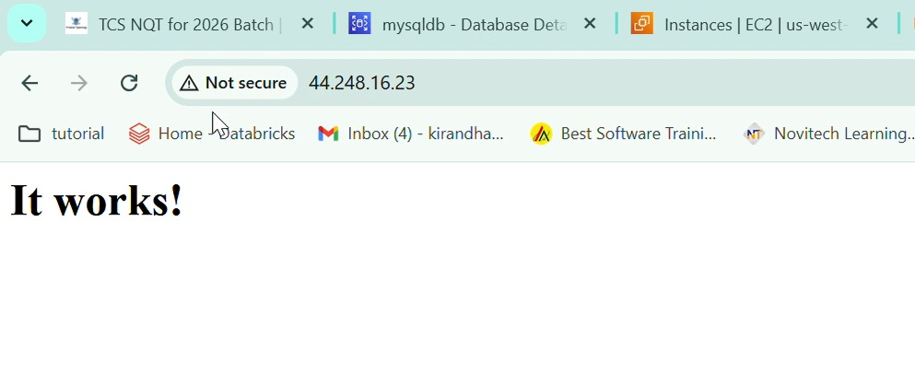
Access The Web Application
This verifies that the EC2 instance is correctly configured,the web server is running ,and the instance is publically accessible

Slide 9
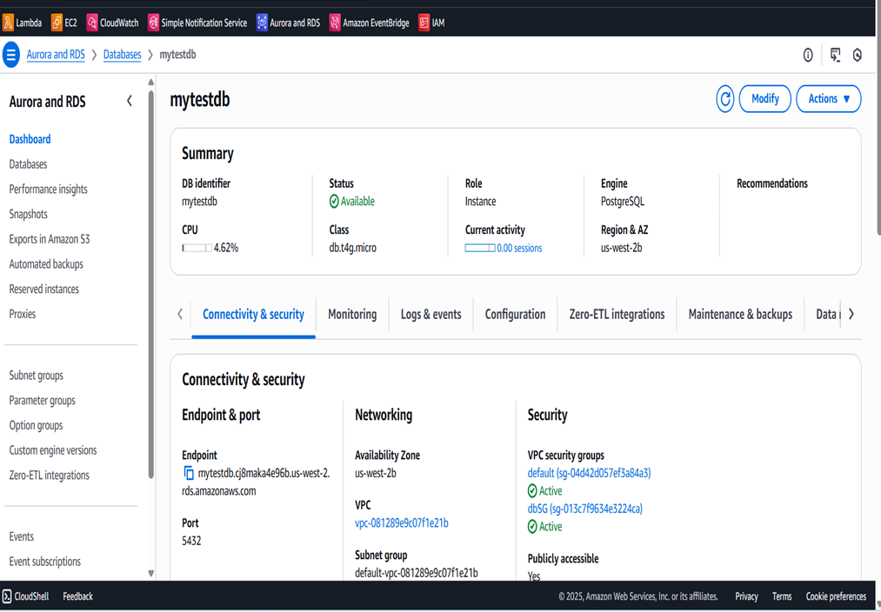
Create RDS MySQL Instance
Console: RDS → Databases → Create database
Action : Engine : PostreSQL
Database name : mytestdb
Credentials : admin / YourPassword
Choose Multi-AZ (optional) for higher availability

Slide 10
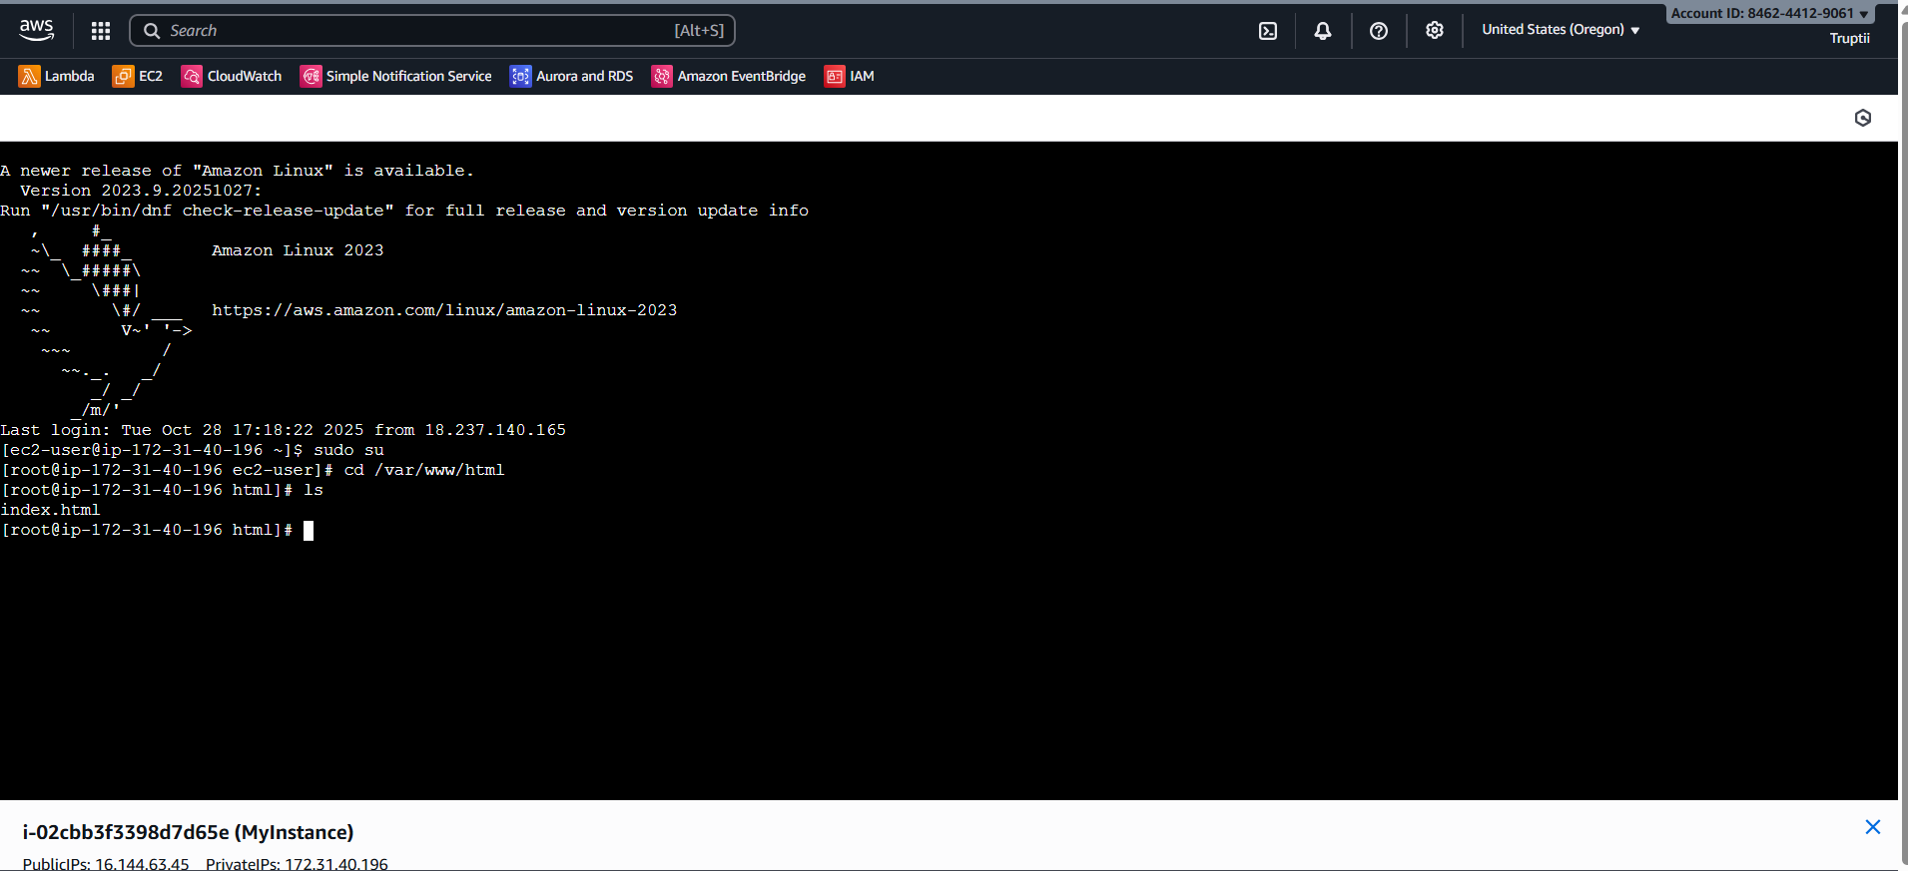
Connect to EC2 Instance
Go to AWS Console → EC2 → Instances → Select your instance → Connect.
Choose the SSH client option.
Once connected, you will see the EC2 command line prompt.
navigate to the folder where your website files will be stored:

Slide 11
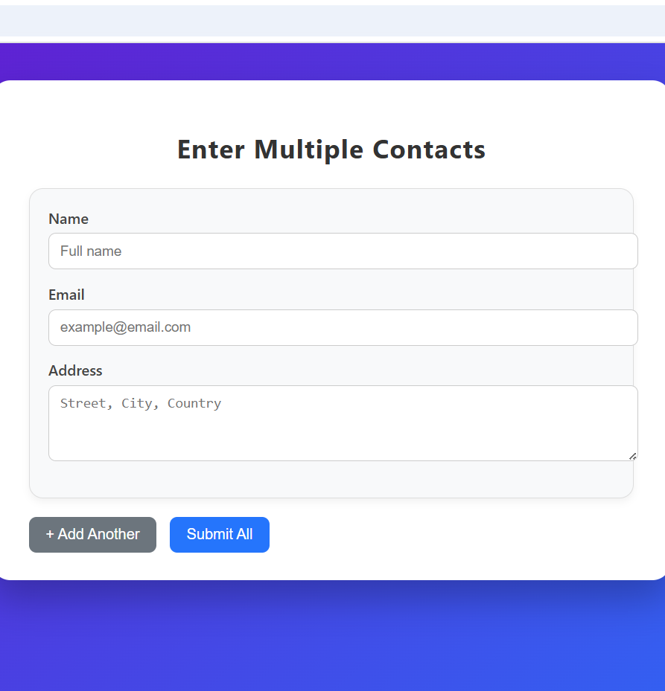
Application Testing create your HTML form and PHP submission file inside /var/www/html.
Create form.html sudo nano form.html
(b) Create submit.php sudo nano submit.php
Again paste your instance ip adding this “/form.html” and check your application is working or not.

Slide 12
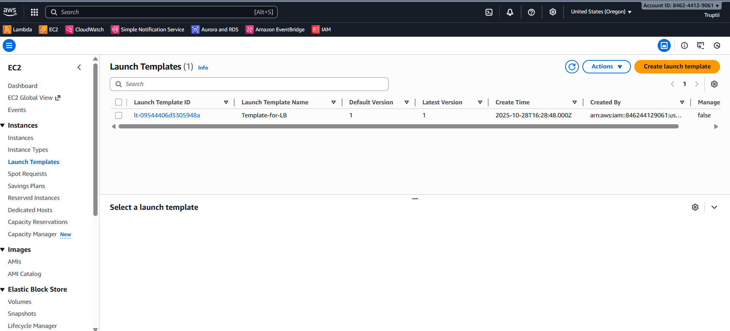
Create Launch Template
Console: EC2 → Launch Templates → Create Launch Template
Action: Created Template-for-LB with same AMI, instance type, key pair, security group and user data configured earlier.

Slide 13
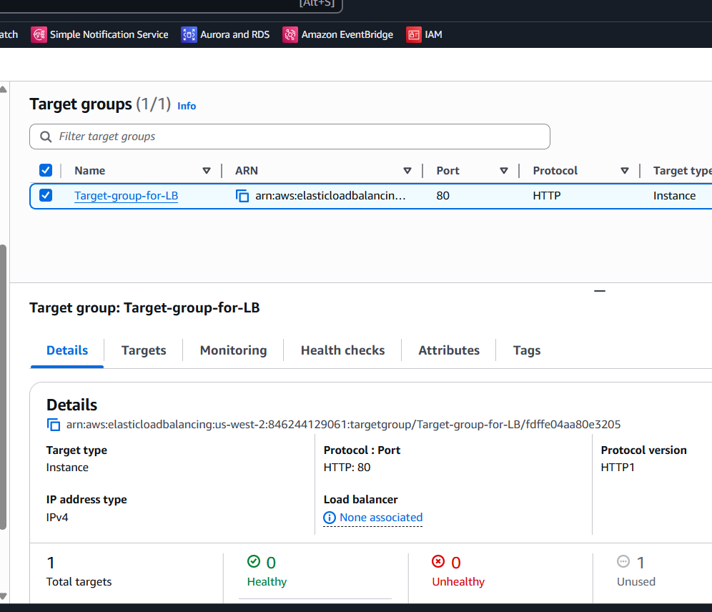
Create a Target Group
Go to EC2 → Load Balancing → Target Groups → Create Target Group.
Choose Target Type: Instance and name it .
Once created, select the target group and register your EC2 instances by clicking on “Register Targets.”
Finally, click Include as pending below and then Register Pending Targets.

Slide 14
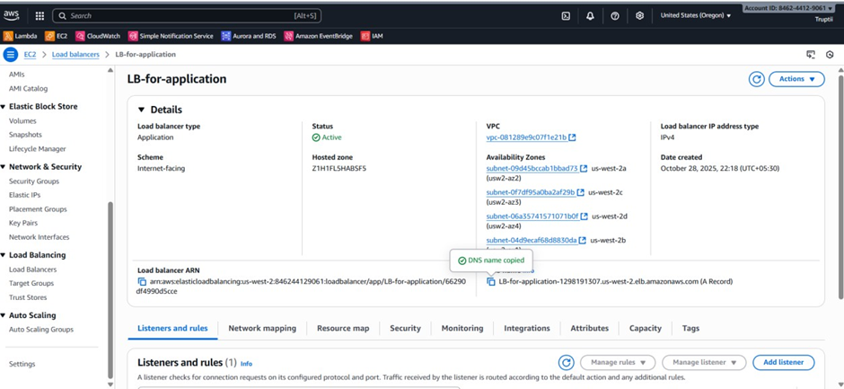
Create an Application Load Balancer (ALB)
The Application Load Balancer distributes incoming web traffic evenly across multiple EC2 instances. It ensures that even if one instance fails, the others continue serving users, maintaining zero downtime.

Slide 15
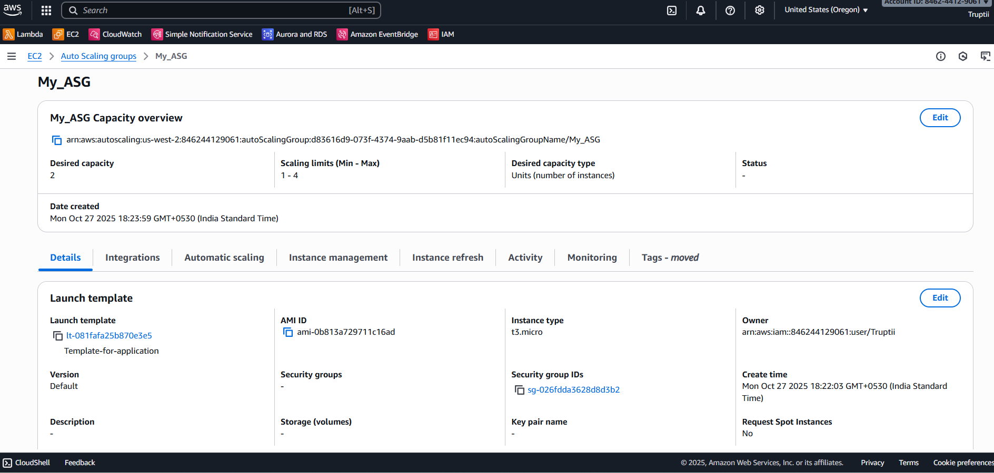
Create an Auto Scaling Group (ASG)

Slide 16
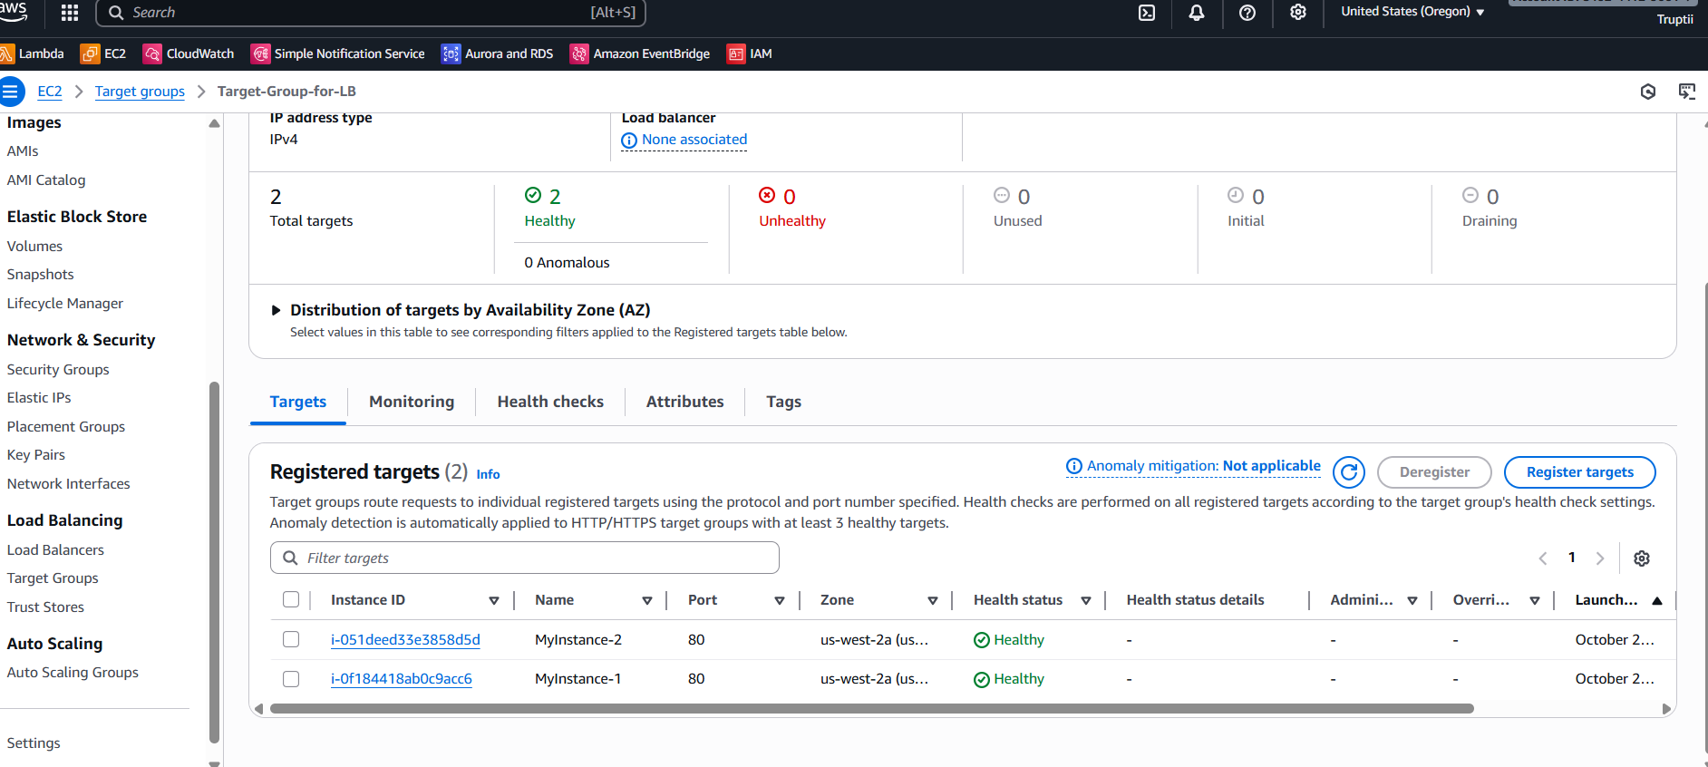
Verify Auto Scaling and Load Balancer Integration

Slide 17
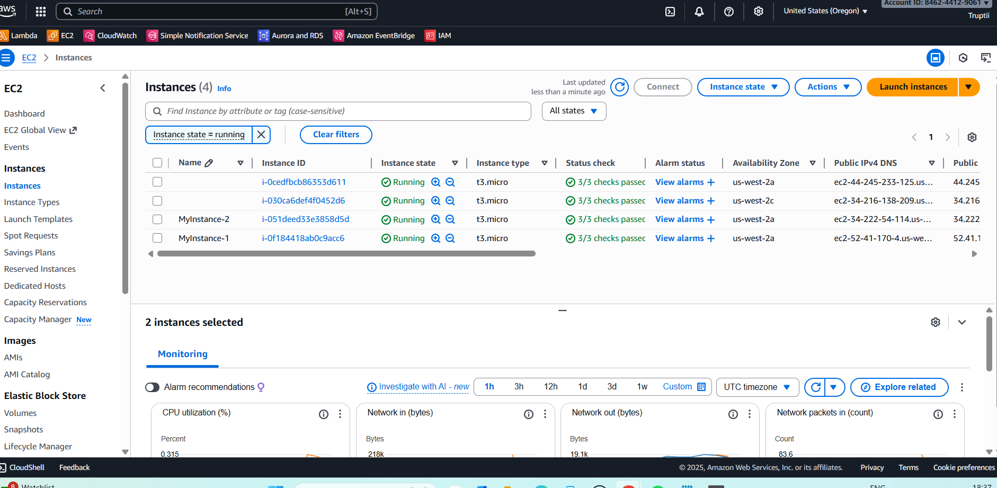
Validate Zero Downtime

Slide 18
CONCLUSION
Using AWS services like EC2, RDS, Load Balancer, Auto Scaling, and CloudWatch, I successfully deployed a highly available web application.
The system handled failures automatically without affecting users.

Slide 19
THANK YOU!

